Slide 1

a

Slide 2
Software Processes
SE-1
Team Members:
Pankaj Gope
Nirav Waghela
Deepak Prakash Lokhande
Abdul Rafay

Slide 3
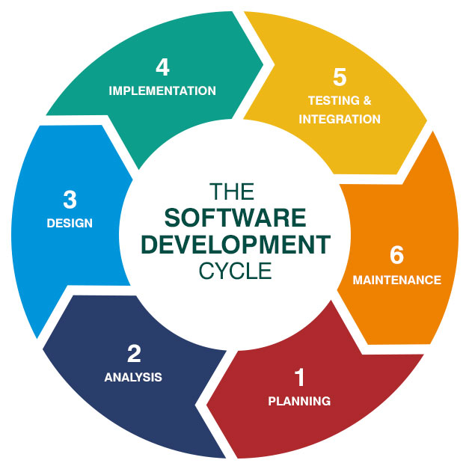
Introduction: Software Processes
The set of instructions in the form of programs that regulate the computer system and execute the hardware components is referred to as software. A series of operations is utilized to create a software product. This collection is known as a software process.
Software Development : This process includes designing, developing, documenting, testing, and bug fixing.
.

Slide 4
What Is the Software Development Life Cycle?
The Software Development Life Cycle is the process of producing software applications using conventional business procedures. It is usually separated into six to eight steps: planning, requirements, design, build, documentation, testing, deployment, and maintenance. Depending on the scale of the project, some project managers will combine, divide, or eliminate steps. These are the essential components for any software development initiatives.
SDLC is a method for measuring and improving the development process. It enables a fine-grained examination of each stage of the process. As a result, businesses may maximize efficiency at each level. As processing power grows, so does the need for software and developers. Companies must save expenses, deploy software faster, and meet or exceed the demands of their consumers. SDLC assists in achieving these goals by finding inefficiencies and increased costs and repairing them so that operations function smoothly..

Slide 5
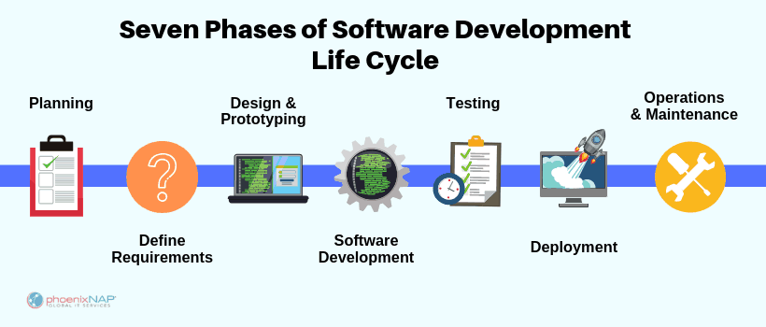
The Seven Phases of the SDLC

Slide 6
Key process activities:
Software Specifications –
In this process, detailed description of a software system to be developed with its functional and non-functional requirements.
Software Development –
In this process, designing, programming, documenting, testing, and bug fixing is done.
Software Validation –
In this process, evaluation software product is done to ensure that the software meets the business requirements as well as the end users needs.
Software Evolution –
It is a process of developing software initially, then timely updating it for various reasons.

Slide 7
Software Processes: not only matter of activities
Products:
The outcomes of a process activity. For example, the outcome of the activity of architectural design may be a model of the software architecture.
Roles:
Reflect the responsibilities of the people involved in the process. Examples of roles are project manager, configuration manager, programmer, etc.
Pre- and post-conditions:
The statements that are true before and after a process activity has been enacted or a product produced. For example, a pre- condition may be that all requirements have been approved by the customer; a post-condition might be that the UML models describing the architecture have been reviewed.

Slide 8
Three crucial Software Crisis
Size and Cost –
Day to day growing complexity and expectation out of software. Software are more expensive and more complex.
Quality –
Software products must have good quality.
Delayed Delivery –
Software takes longer than the estimated time to develop, which in turn leads to cost shooting up.

Slide 9
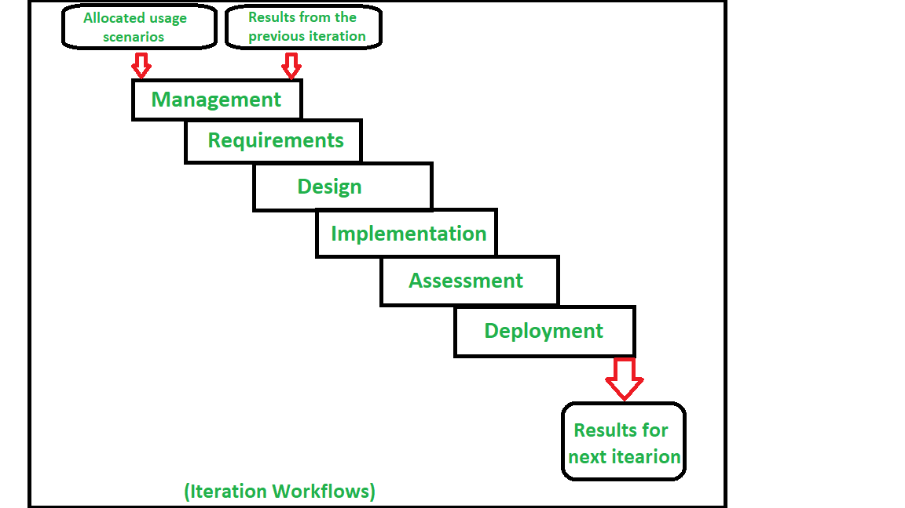
Software Process Model:
A software process model is an abstraction of the actual process, which is being described. It can also be defined as a simplified representation of a software process. Each model represents a process from a specific perspective.Basic software process models on which different type of software process models can be implemented:
1. A workflow Model –
It is the sequential series of tasks and decisions that make up a business process.

Slide 10
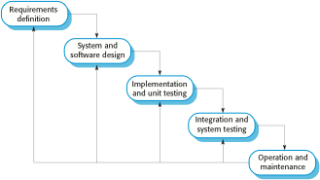
Software Process Model:
2. The Waterfall Model –
It is a sequential design process in which progress is seen as flowing steadily downwards. Phases in waterfall model:
(i) Requirements Specification
(ii) Software Design
(iii) Implementation
(iv) Testing
(v) Operation and Maintanance

Slide 11
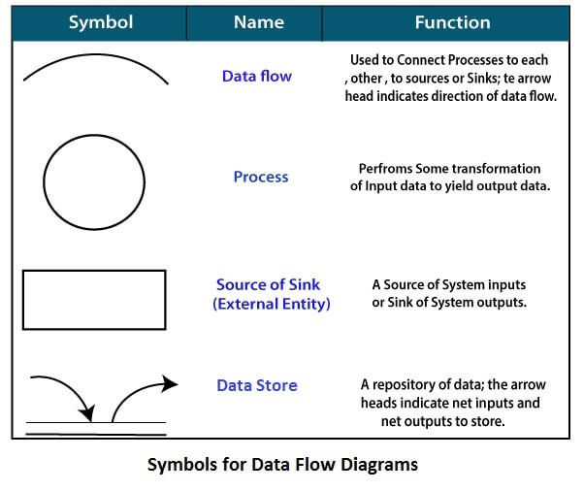
Software Process Model:
3. Dataflow Model –
It is diagrammatic representation of the flow and exchange of information within a system.

Slide 12
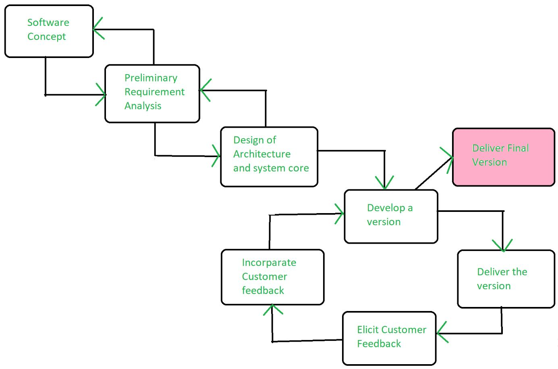
Software Process Model:
4. Evolutionary Development Model –
Following activities are considered in this method:
(i) Specification
(ii) Development
(iii) Validation

Slide 13
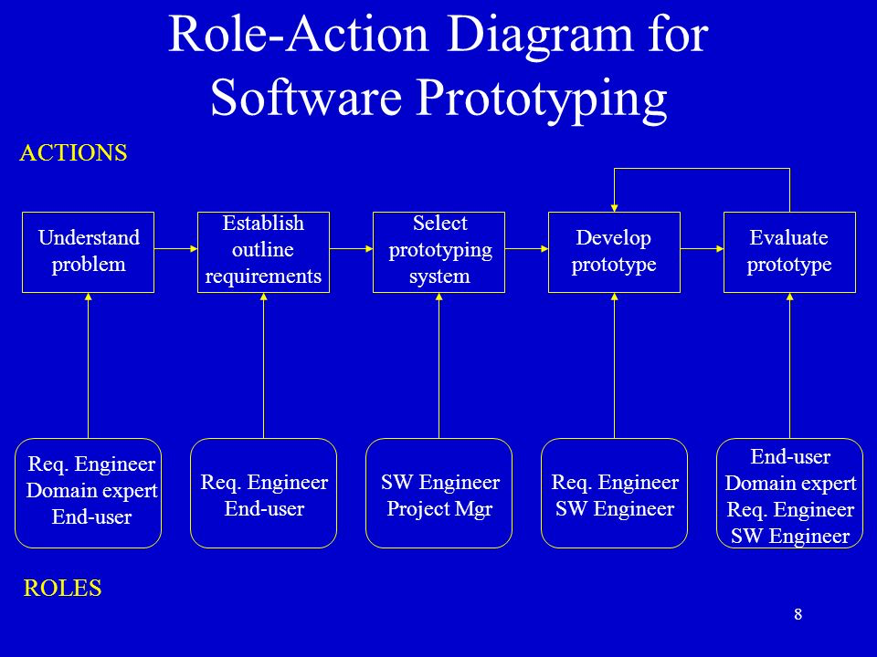
Software Process Model:
5. Role / Action Model –
Roles of the people involved in the software process and the activities.

Slide 14
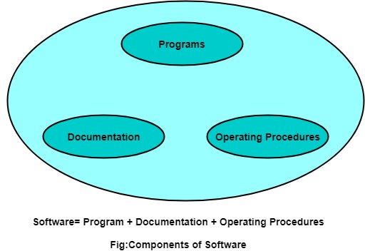
Components of Software :
There are three components of the software:
1. Program –
A computer program is a list of instructions that tell a computer what to do.
2. Documentation –
Source information about the product contained in design documents, detailed code comments, etc.
3. Operating Procedures –
Set of step-by-step instructions compiled by an organization to help workers carry out complex routine operations.
There are three components of the software as shown in fig:

Slide 15
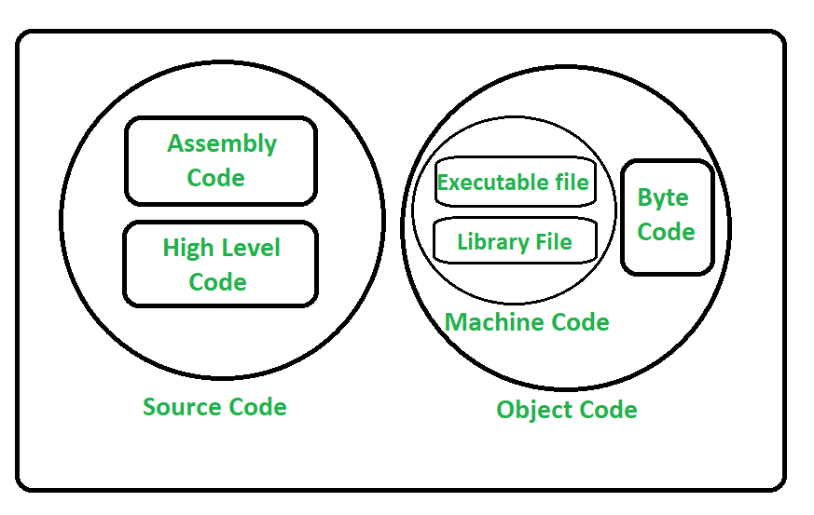
Program vs. Software
1. Program: Program is a combination of source code & object code.

Slide 16
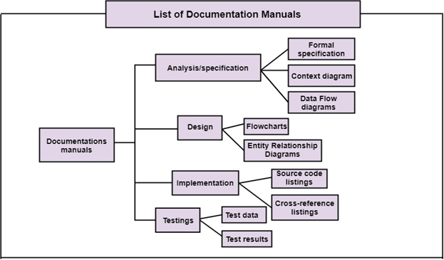
Program vs. Software
2. Documentation: Documentation consists of different types of manuals. Examples of documentation manuals are: Data Flow Diagram, Flow Charts, ER diagrams, etc.

Slide 17
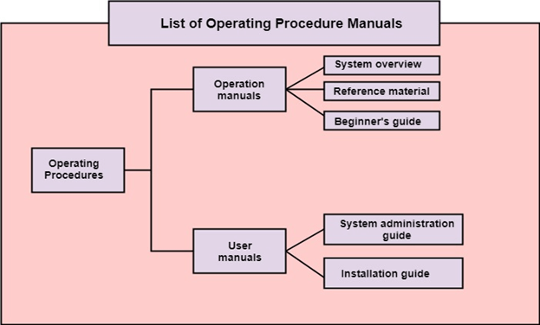
Program vs. Software
3. Operating Procedures: Operating Procedures consist of instructions to set up and use the software system and instructions on how react to the system failure. Example of operating system procedures manuals is: installation guide, Beginner's guide, reference guide, system administration guide, etc.

Slide 18
Conclusion
Understood the principles of software engineering
Understood what we mean by a software process
Note the two major classifications of processes and note also that there are numerous hybrid classifications within these.
Software processes are the activities involved in producing a software system.
Software process models are abstract representations of these processes.

Slide 19
References
https://www.tutorialspoint.com/sdlc/sdlc_overview.htm
https://www.geeksforgeeks.org/software-processes-in-software-engineering/
https://www.javatpoint.com/software-processes
http://www.cs.unibo.it/~nuzzoles/courses/sw-applications/slides/4_Software_Processes.pdf
https://phoenixnap.com/blog/software-development-life-cycle

Slide 20
Thank you!

